Slide 1
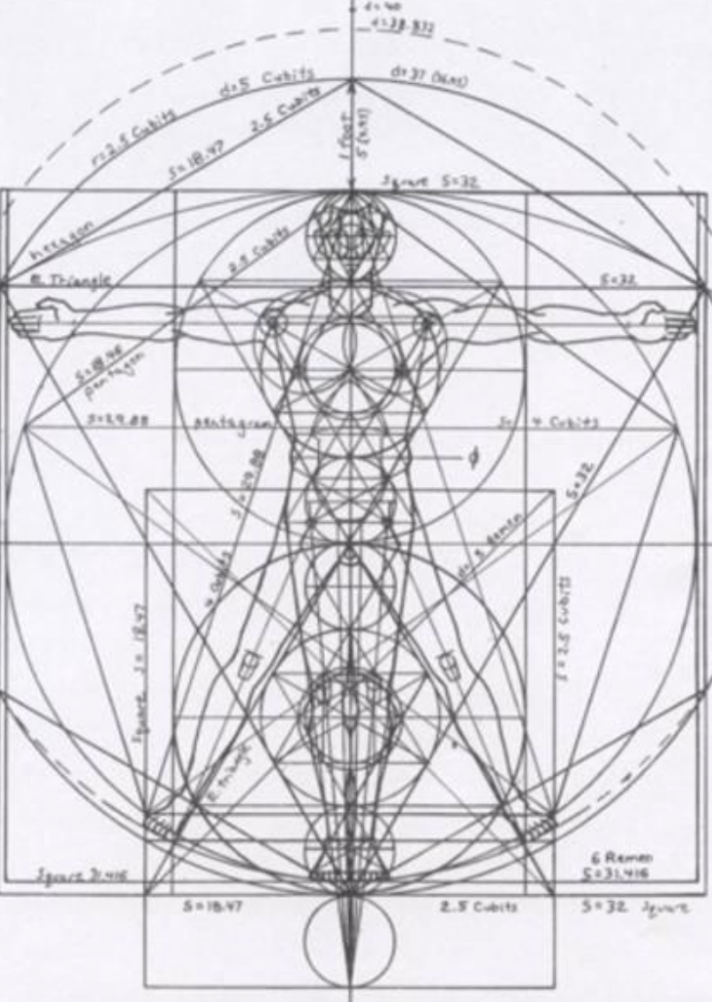
Not as Unwise but as Wise: Reflections from C.S. Lewis's The Abolition of Man and That Hideous Strength on Living Christianly in a Post-Christian World
November 17, 2021 -- St. Philip’s Church
The Rev’d Brian K. McGreevy, J.D., Facilitator

Slide 2
For at one time you were darkness, but now you are light in the Lord.
Walk as children of light (for the fruit of light is found in all that is good and right and true), and try to discern what is pleasing to the Lord. Take no part in the unfruitful works of darkness, but instead expose them. For it is shameful even to speak of the things that they do in secret. But when anything is exposed by the light, it becomes visible, for anything that becomes visible is light. Therefore it says, “Awake, O sleeper,
and arise from the dead, and Christ will shine on you.”
Look carefully then how you walk, not as unwise but as wise,
making the best use of the time, because the days are evil. Therefore do not be foolish,
but understand what the will of the Lord is.
Ephesians 5: 8-17

Slide 3
How to approach this class: --On the beach --Snorkeling --Scuba diving --Email list How to read The Abolition of Man:
--Why it’s not an easy read—original audience and the premises of Natural Law --Try reading aloud --One paragraph at a time
What we’ll be doing each week:
--Examining context and establishing a framework for appreciating these books
--Unpacking the meaning of Lewis’s works
--Exploring their relevance for today
--Considering how we can respond with practices of Hope and of Wisdom rooted in the Scriptures

Slide 4
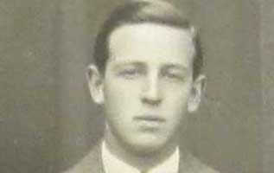
Review from previous classes:
I. How did C.S. Lewis come to write these two books, what was the context, and how are these two books connected?
--C.S. Lewis and how his background prepared him for writing these books: converted atheist, philosopher
II. Education and its fundamental importance for how we view the world
--Liberal Arts--St. Augustine: wrote that part of the answer to the despair of skepticism is found in the Christian conviction that Truth is attainable and that knowledge and wisdom are possible, because all Truth derives from God in His creation and His Law, perfectly revealed in Jesus Christ. In City of God, Augustine defined virtue as “rightly ordered love.”
Universities and the Liberal Arts Education, and particularly higher education, was part and parcel of the mission of the Church from its earliest days. Universities were unknown in the ancient world and only came into being because the Church started them. What we think of as the great universities like Oxford and Harvard were robustly Christian in their original mission statements.
Whatever Happened to Philosophy? Philosophy was considered THE most important part of education, and was invariably a required part of university studies—answering these questions was the real WHY people went to college. However, over the past 50 years the study of philosophy has shrunk, first being subsumed into a required Western Civilization course, then made optional, and then disdained as IMPRACTICAL (won’t help you get a job), politically incorrect, and harmful (Patriarchy of Dead White Men).
So he sent the word to slay/And slew the little childer “Surely it must have been a kind of macabre joke on Lewis’s part to preface a critique of textbooks with these lines? But no: Herod could but kill the body; our teachers (Lewis thinks) are killing our children’s souls, and this is the more grievous sin.”—Lewis scholar Alan Jacobs

Slide 5
CHAPTER 1: MEN WITHOUT CHESTS
--Gaius, Titius, and The Green Book
--Characteristics of Waterfalls and the Biblical Idea of Living Water--“They have forsaken me, the spring of living water, and have dug their own cisterns, cisterns that cannot hold water” Jeremiah 2:13
Lewis believes that Beauty is a real, objective value which we can be taught to recognize and to love.
Augustine’s On Christian Doctrine:: “Living a just and holy life requires one to be capable of an objective and impartial evaluation of things: to love things, that is to say, in the right order.”
--Trained emotions: Without the aid of trained emotions (learning to love what is True, Beautiful, and Good), the intellect or mind which knows what to do is powerless against the animal organism. Only as the Chest, the seat of emotions and sentiments, is rightly trained to respond in accordance with objective moral values, will it be able to control the appetites of the Belly.
--Eustace Scrubb, Experiment House, and education: Eustace had read all the wrong books!
--Another Lens: The Abolition of Man’s argument as expressed in Mere Christianity: Right and wrong are clues to the meaning of the universe because of the Law of Human Nature.
Friedrich Wilhelm Nietzsche (1844-1900) German philosopher who is known as the father of Nihilism. Nihilism is the belief that all values are baseless and that nothing can be known or communicated.
Jacques Derrida (1930-2004) French philosopher influenced by Nietzsche, known for his theory of Deconstruction We must stop considering everything in life, culture and thought in relation to absolute truth, because to do so is oppressive and immoral. Through its vehement opposition to logocentrism (the belief that there is a realm of truth that exists prior to and independently of its representation by linguistic and other signs), Deconstructionism robs the world of meaning and wonder.
Michel Foucault (1926-1984) French public intellectual There are no moral facts whatever. The Self is no longer considered as passively conforming to external realities, but as the active agent of its own creation.

Slide 6
CHAPTER 2: THE WAY
--Not No Values but Whose Values? “The practical result of education in the spirit of The Green Book must be the destruction of the society which accepts it”…because of the elimination of Objective Value.
--“This thing which I have called for convenience the Tao, and which others may call Natural Law or Traditional Morality or the First Principles of Practical Reason or the First Platitudes, is not one among a series of possible systems of value. It is the sole source of all value judgements. If it is rejected, all value is rejected. …The rebellion of new ideologies against the Tao is a rebellion of the branches against the tree: if the rebels could succeed they would find that they had destroyed themselves.”
The End: No Values at All: “‘Let us regard all ideas of what we ought to do simply as an interesting psychological survival: let us step right out of all that and start doing what we like. Let us decide for ourselves what man is to be and make him into that: not on any ground of imagined value, but because we want him to be such. Having mastered our environment, let us now master ourselves and choose our own destiny’
…This is a very possible position: and those who hold it cannot be accused of self-contradiction like the half-hearted sceptics who still hope to find ‘real’ values when they have debunked the traditional ones. This is the rejection of the concept of value altogether.”
CHAPTER 3: THE ABOLITION OF MAN
Summary adapted from Rev. Dr. Michael Ward in After Humanity
--We will no longer find the solutions to the problems of life in knowledge self-discipline and virtue but increasingly in willpower, technological control, and surgical alteration of nature to suit our own convenience.”
--Elite minorities in politics, education, medicine, and related fields will hold positions of influence and will admit no moral constraints on their behavior.
What we call Man’s power over Nature turns out to be a power exercised by some men over others with Nature as its instrument… the power of Man to make himself what he pleases means…the power of some men to make other men what they please.”

Slide 7
“New” education Educators freed from the Tao can inculcate judgments of value in the pupil as part of the conditioning, to choose what kind of artificial Tao they will, for their own good reasons, produce in the human race.
The Final Frontier “To reduce the Tao to a mere natural product is a step of that kind [into the abyss]. Up to that point, the kind of explanation which explains things away may give us something, though at a heavy cost. But you cannot go on ‘explaining away’ for ever: you will find that you have explained explanation itself away. You cannot go on ‘seeing through’ things for ever. The whole point of seeing through something is to see something through it. It is good that the window should be transparent, because the street or garden beyond it is opaque. How if you saw through the garden too? It is no use trying to ‘see through’ first principles. If you see through everything, then everything is transparent. But a wholly transparent world is an invisible world. To ‘see through’ all things is the same as not to see.”
Summary: Main theme of each chapter in The Abolition of Man
1. “Men without Chests”: The importance of objective values and the poison of subjectivism
2. “The Way”: Why the Tao, or Natural Law, is the sole source of all value judgments
3. “The Abolition of Man”: “Man’s control of Nature” is in reality a means for some men (Conditioners) to control other men, using Nature as their instrument. To “see through” (deconstruct) all things is not to see at all.

Slide 8
Importance of The Abolition of Man
Later in life, Lewis wrote that The Abolition of Man "is almost my favourite among my books, but in general has been almost totally ignored by the public.” Despite Lewis’s assessment that Abolition had been ignored, it has proven to be one of the most important things Lewis ever wrote. The Intercollegiate Review named it one of the five nonfiction books of the 20th century. The National Review ranks it seventh on its list of the top nonfiction books of the 20th century. Professor Alasdair McIntyre, perhaps the most eminent philosopher of this era, was hugely influenced by this work in his seminal volume After Virtue. Ayn Rand certainly didn’t ignore it, though she didn’t much like it--calling it “abysmal scum” and a “cheap, awful, touchy, social-metaphysical mediocrity.”
One fascinating aspect of its reception is that it is widely praised by non-Christian as well as Christian scholars. Renowned atheist philosopher John Gray called Abolition “prescient”, “prophetic”, and as relevant now as when it first came out, “if not more so.” A wide range of Christian scholars have praised it as well: Anglican evangelical scholar Alan Jacobs has called it “the most profound of Lewis’s cultural critiques,” with Joseph Ratzinger (Pope Benedict XVI) praising the “keen accuracy” of its moral diagnosis. A.N. Wilson, Hans Urs von Balthasar, Francis Fukuyama, and Wendell Berry have all praised the book, and as one commentator said, “A book that attracts enthusiastic responses from Catholics, Protestants, and atheists is probably doing something pretty significant.”
A final comment from Rev. Dr. Michael Ward, eminent Lewis scholar and author of After Humanity, the most important guide to The Abolition of Man:
“[Lewis is] arguing that moral law is a premise; it’s not a conclusion. We have to accept it as a given; we can’t argue to it, we must argue from it. It’s an objective reality which we didn’t make up: we must submit to it, we must surrender to it and grow up within it. It’s like a trellis with which you would train a climbing rose.

Slide 9
“But if you take the opposite view, that we create moral law according to our own subjective preferences, you can do whatever you like—because there’s nothing that is objectively real in the moral world. No, it’s just whatever you happen to choose.
“Happiness consists in conforming oneself to reality, not twisting reality to suit your own convenience, or your own desires. The common modern-day phrase “speaking my truth” connects very precisely with this prophecy that Lewis is making—that we’ll all just determine reality according to our own particular perspective, which leads to moral anarchy and therefore to a “post-truth” world.”
Convinced of the crucial importance of the themes he addressed in The Abolition of Man, Lewis decided to portray them in the form of a story for the last volume in the Ransom trilogy, which he entitled That Hideous Strength. The title comes from a line in a poem by Sir David Lyndsay called “Ane Dialog” (1555) in which Lyndsay was describing the biblical Tower of Babel (Genesis 11: 1-9): “The shadow of that hideous strength, Six miles and more it is of length.” In the Preface to That Hideous Strength, Lewis states, “This is a ‘tall story‘ [pun probably intended] about devilry, though it has behind it a serious ‘point’ which I have tried to make in my Abolition of Man.”
In The Abolition of Man, among many things, Lewis offered his thoughts to a scholarly audience, arguing (without reference to theology) on the purpose of education, the natural law tradition, and the necessity of moral oversight of the institution of science and its practitioners. In That Hideous Strength: A Modern Fairy-Tale for Grown-Ups, first published in 1945, he breathes life into these same ideas in his description of the aggressive vision of the scientific group called the N. I. C. E. (National Institute for Coordinated Experiments), and in his attribution of the
N. I. C. E.’s views and actions to the demons, or … “devilry.”

Slide 10
PLOT SUMMARY OF THE RANSOM TRILOGY
Adapted from Taylor Dinerman, The Space Review
“Out of the Silent Planet, tells how Ransom, a Cambridge don on holiday, is kidnapped by the physicist Weston and his partner Devine, a sleazy businessman, and taken to Malacandra (Mars), supposedly as a human sacrifice. Once on Mars he escapes, hides in a Martian village, and learns to speak the local language. He learns that each planet has its own tutelary spirit—essentially an angel or archangel—called an Oyarsa, who rules under the authority of God. Earth, unfortunately, is the central battleground between Good and Evil and is ruled by a fallen angel, a dark Oyarsa.
“Perelandra, the name Lewis gives to Venus, is also the title of the second book in the series. Retelling the story of Adam and Eve, it is the most explicitly biblical of the three. Weston plays the role of the serpent sent to tempt the woman who is to become the mother of the world into rejecting God’s will. Ransom is sent by the Oyarsa to challenge the evil one and to save Venus from the fate of Earth.
“That Hideous Strength has little to do with space travel, and everything to do with the conflict between Good and Evil. It is perhaps the most subtle of the stories. It combines a sordid tale of intra-university politics, Arthurian legend, and spiritual combat. In a small British University town, based loosely on Durham, in the North of England, one of the colleges finds itself seduced and then engulfed by the newly established National Institute for Coordinated Experiments (N.I.C.E). This organization is secretly controlled by a pair of initiates, who plan to revive the wizard Merlin from his long, enchanted slumber and to use his powers for their own malevolent purposes. To find him they need the services of a ‘seer’; Jane Studdock, the wife of Mark Studdock, a shallow young sociologist. Mark is entrapped by promises of power, money, and above all membership in the secret, elite clique that controls the N.I.C.E. Ransom leads a small eccentric company of friends who, with the aid of the Oyarsa, take on and defeat them.”

Slide 11
Cosmology of Deep Heaven
“Ransom gets much information on the cosmology of Deep Heaven from the Oyarsa (presiding angel) of Malacandra, or Mars. Maleldil (God) rules the Field of Arbol (the Solar System) directly. But then the Bent One (the Oyarsa of Earth) rebelled against Maleldil and all the eldila of Deep Heaven (Outer Space). In response to this act, the Bent One suffered confinement on Earth where he first inflicted great evil. Thus he made Earth a Silent Planet, cut off from the Oyéresu of other planets, hence the name 'Thulcandra', the Silent Planet, which is known throughout the Universe. Maleldil tried to reach out to Thulcandra and became a man to save the human race. According to the Green Lady, Tinidril (Mother of Perelandra, or Venus), Thulcandra is favored among all the worlds, because Maleldil came to it to become a man. In the Field of Arbol, the outer planets are older, the inner planets newer. The Asteroids are called the "dancers before the threshold of the Great Worlds.”
“Earth will remain a silent planet until the end of the great Siege of Deep Heaven against the Oyarsa of Earth. The siege starts to end with the Oyéresu of other worlds descending to Earth at the finale of the Trilogy, That Hideous Strength. But there is still much to happen until the fulfillment of what is predicted in the Book of Revelation, when the Oyéresu put an end to the rule of the Bent Eldil and, on the way, smash the Moon to fragments. This, in turn, will not be "The End of the World", but merely "The Very Beginning" of what is still to come.
Eldila
“The eldila (singular eldil) are super-human extraterrestrial creatures like angels. The human characters in the trilogy encounter them on various planets, but the eldila themselves are native to interplanetary and interstellar space ("Deep Heaven"). They are barely visible as pillars of faint, shifting light. Certain powerful eldila, the Oyeresu (singular Oyarsa), control the course of nature on each of the planets of the Solar System They can manifest in corporeal forms.

Slide 12
Oyarsa
“The title Oyarsa seems to indicate the function of leadership, regardless of the leader's species. The eldila are science-fictionalised depictions of angels, immortal and holy, with the Oyéresu perhaps being angels of a higher order. (As Lewis implies in Chapter 22 of Out of the Silent Planet, the name Oyarsa was suggested by Oyarses, the name given in Bernard Silvestri’s Cosmographia to the governors of the celestial spheres. Bernard's word was almost certainly a corruption—or a deliberate alteration—of Greek οὐσιάρχης [ousiarches, "lords of being"], used with the same meaning in the Hermetic Asclepius (150 BC). The eldila resident on—actually, imprisoned in—Earth are "dark eldila” (Fallen angels or Demons). The Oyarsa of Earth, the "Bent One", is Satan. Ransom later meets the Oyéresu of both Mars and Venus, who are described as being masculine (but not actually male) and feminine (but not actually female), respectively. The Oyéresu of other worlds have characteristics like those of the corresponding Classical gods; for instance, the Oyarsa of Jupiter gives a feeling of merriment (joviality).”
Hnau
“Hnau is a word in the Old Solar language which refers to "rational animals" such as Humans. In the book, the Old Solar speaker specifies that God is not hnau. The term was adopted by some other people, including Lewis's friend J.R.R. Tolkien, who used the term in his posthumously published book, The Notion Club Papers - distinguishing hnau from beings of pure spirit or spirits able to assume a body (which is not essential to their nature). In recent times the term has been used by some philosophers, for example in Thomas I. White's "Is a Dolphin a Person?", where he asks if Dolphins are persons, and if such, if they can also be reckoned as hnau: that is sentient beings of the same level as humans.”
--adapted from Wikipedia entry on the Space Trilogy

Slide 13
Old Solar language
“According to the Space Trilogy's cosmology, the speech of all the inhabitants of the Field of Arbol is the Old Solar language, or Hlab-Eribol-ef-Cordi. Out of all the planets, only Earth lost this language, due to the Bent One's influence. Old Solar can be likened to the Elvish languages invented by Lewis's friend, Tolkien. The grammar is little known, except for the plurals of nouns. Old Solar is also referred to as "the Great Tongue,” for this was the language spoken before the Fall and beyond the Moon:
“It was as if the words spoke themselves … from some strong place at a distance--or as if they were not words at all but present operations of God, the planets, and the Pendragon. For this was the language spoken before the Fall and beyond the Moon and the meanings were not given to the syllables by chance, or skill, or long tradition, but truly inherent in them as the shape of the great Sun is inherent in the little waterdrop. This was Language herself, as she first sprang at Maleldil's bidding out of the molten quicksilver of the first star, called Mercury on Earth, but Viritrilbia in Deep Heaven.”—from That Hideous Strength

Slide 14
Practices of Hope and of Wisdom
Finally, brothers, whatever is true, whatever is honorable, whatever is just, whatever is pure, whatever is lovely, whatever is commendable, if there is any excellence, if there is anything worthy of praise, think about these things. What you have learned and received and heard and seen in me—practice these things, and the God of peace will be with you.—Philippians 4:8-9
1. Listen to Gustav Holst’s The Planets and reflect on the wonder of God’s creation of the night sky. The Planets is a seven-movement orchestral suite by the English composer Gustav Holst written between 1914 and 1917. In the last movement the orchestra is joined by a chorus. Each movement of the suite is named after a planet of the Solar System and its astrological character, related to the medieval cosmology which Lewis loved. The premiere of The Planets was at the Queen’s Hall in London on 29 September 1918, conducted by Holst's friend Sir Adrian Boult. The seven movements are
Mars, the Bringer of War
Venus, the Bringer of Peace
Mercury, the Winged Messenger
Jupiter, the Bringer of Jollity
Saturn, the Bringer of Old Age
Uranus, the Magician
Neptune, the Mystic

Slide 15
2. Meditate on these verses about the beauty of God’s creation in the Heavens:
--He who made the Pleiades and Orion, who turns midnight into dawn and darkens day into night, who calls for the waters of the sea and pours them out over the face of the land— the LORD is his name. (Amos 5:8)
--Lift up your eyes and look to the heavens: Who created all these? He who brings out the starry host one by one and calls forth each of them by name. Because of his great power and mighty strength, not one of them is missing. (Is. 40:26)
--“Where were you when I laid the foundation of the earth? Tell me, if you have understanding. Who determined its measurements—surely you know! Or who stretched the line upon it? On what were its bases sunk, or who laid its cornerstone, when the morning stars sang together and all the sons of God shouted for joy? (Job 38:4-7)
--Psalm 8
3. Go somewhere outdoors where you can see the night sky and spend some time in prayer praising God for the Beauty He has created.
We magnify Thee, O Lord, we bless the excellency of thy name in the great work of thy hands, the manifold vestures of earth and sky and sea, the courses of the stars and light, the songs of the birds, the hues of flowers, the frame and attributes of everything that hath breath, and, upholding all, thy wisdom, marvelous worthy to be praised, but most, that by thy sure promise we now do only taste the glory that shall be revealed, when thou, O God, wilt take the power and reign, world, without end. Amen. (prayer by the Rev. Eric Milner-White, 1933)

Slide 16
For at one time you were darkness, but now you are light in the Lord.
Walk as children of light (for the fruit of light is found in all that is good and right and true),
and try to discern what is pleasing to the Lord. Take no part in the unfruitful works of darkness,
but instead expose them. For it is shameful even to speak of the things that they do in secret.
But when anything is exposed by the light, it becomes visible, for anything that becomes visible is light.
Therefore it says, “Awake, O sleeper, and arise from the dead,
and Christ will shine on you.”
Look carefully then how you walk, not as unwise but as wise,
making the best use of the time, because the days are evil. Therefore do not be foolish,
but understand what the will of the Lord is.
Ephesians 5: 8-17

