Slide 1
September 28, 2022 St. Philip’s Church The Rev’d Brian K. McGreevy, J.D., Facilitator
The Great Divorce:
C.S. Lewis on God’s Truth
or Your Truth

Slide 2
In the presence of God and of Christ Jesus, who will judge the living and the dead, and in view of his appearing and his kingdom, I give you this charge: Preach the word; be prepared in season and out of season; correct, rebuke and encourage—with great patience and careful instruction.
For the time will come when people will not put up with sound doctrine. Instead, to suit their own desires, they will gather around them a great number of teachers to say what their itching ears want to hear. They will turn their ears away from the truth and turn aside to myths. But you, keep your head in all situations, endure hardship, do the work of an evangelist, discharge all the duties of your ministry. (2 Timothy 4:1-4)

Slide 3
How to approach this class: --On the beach --Snorkeling --Scuba diving --Email list How to read this book: --Try reading aloud --One chapter at a time
AN ANNOUNCEMENT!

Slide 4
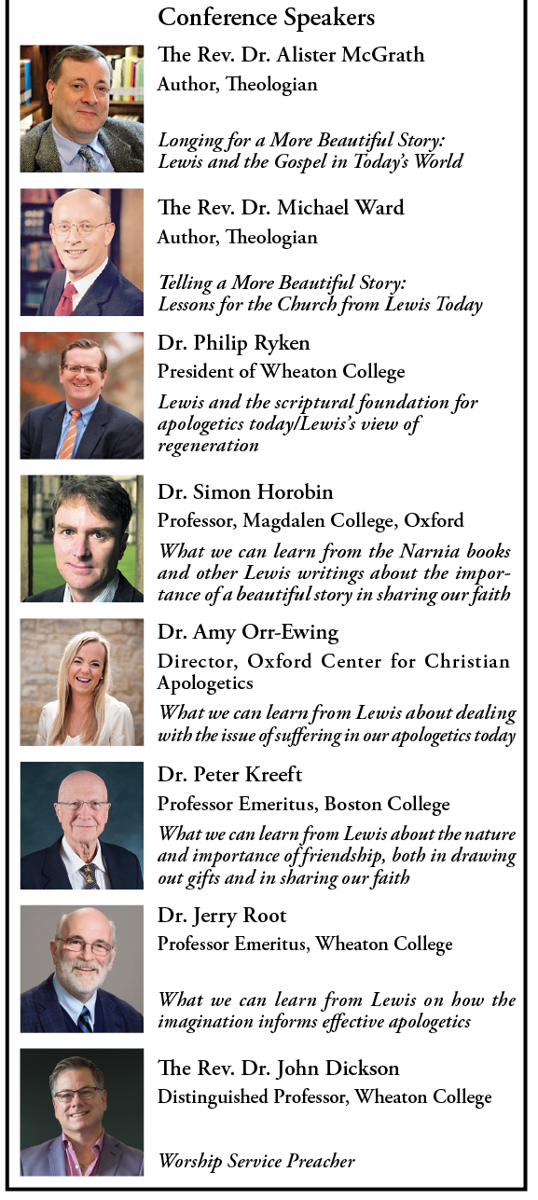
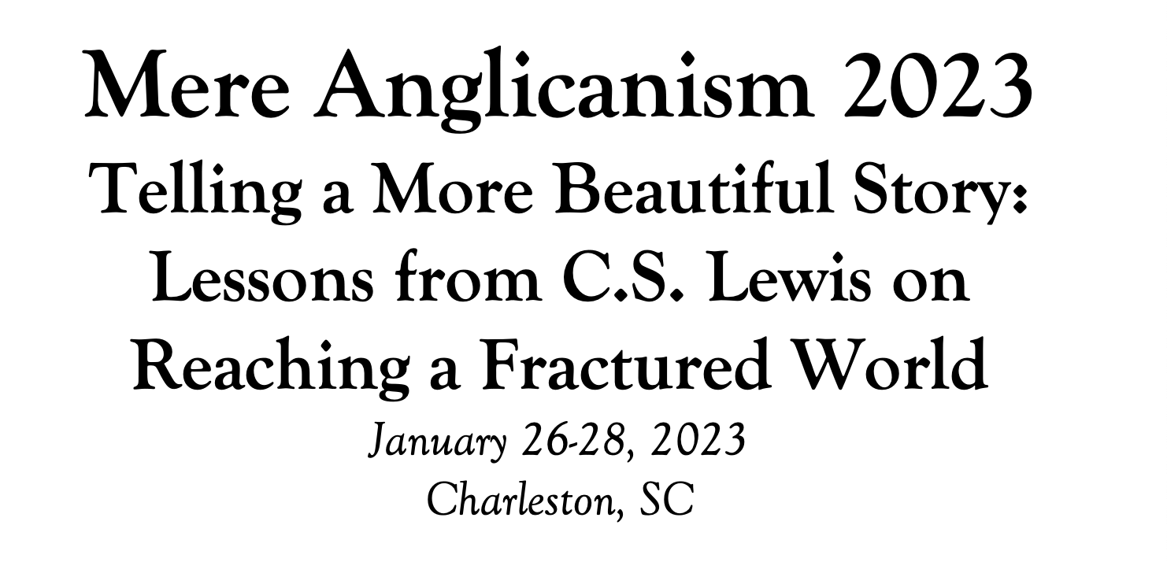

Slide 5
Tonight’s music!
REVIEW
--Who was C.S. Lewis?
--Why does The Great Divorce merit study today?
--Review of Context: England in Wartime Other works Lewis was writing during this same period The RAF ministry of Lewis and its impact on his writing
--Front matter:
The title
The frontispiece
The preface

Slide 6
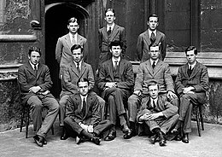
Who was C.S. Lewis?
Why does The Great Divorce merit study today?
--Emphasis on eternal life with a vivid description of the awfulness of Hell and the glorious beauty of Heaven that will fire your heart with longing
--Narcissism and pride are rife in our culture today, and Lewis shows the consequences of both.
--Truth as an absolute is under cultural attack as never before, with the idea of speaking your own truth held up as the highest good. Lewis shows decisively in this story what happens when you hold onto your own ”truth” and refuse to acknowledge God’s Truth.
--Obsession in our culture about our Rights and what we are owed, rather than focusing on servanthood and self-sacrifice
--Clarity about either/or rather than gray view of choices
--A brilliant rebuttal of works righteousness in favor of the centrality of the Cross

Slide 7
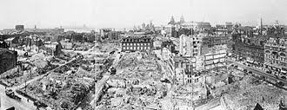
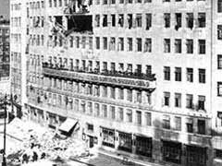
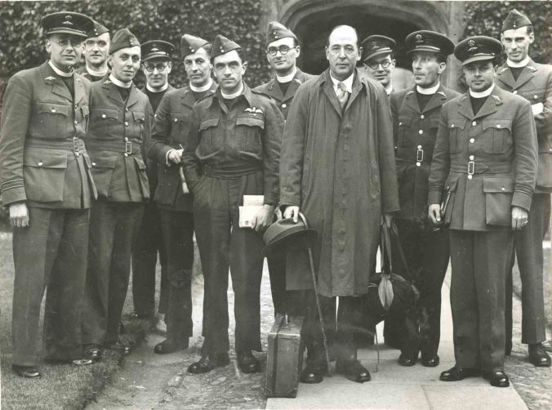
England in Wartime
“The end of the world” state of affairs and ultimate questions
Lewis’s role in the RAF and what he learned that influenced his writings
Lewis wrote to a friend that his first talk was “a complete failure,” taking comfort in the fact that “God used an ass to convert the prophet.” Lewis learned from his initial failures as a speaker. Reminded that the RAF chaplains were “probing life in the raw and trying to do something about it,” he began choosing more down-to-earth and personal topics.

Slide 8
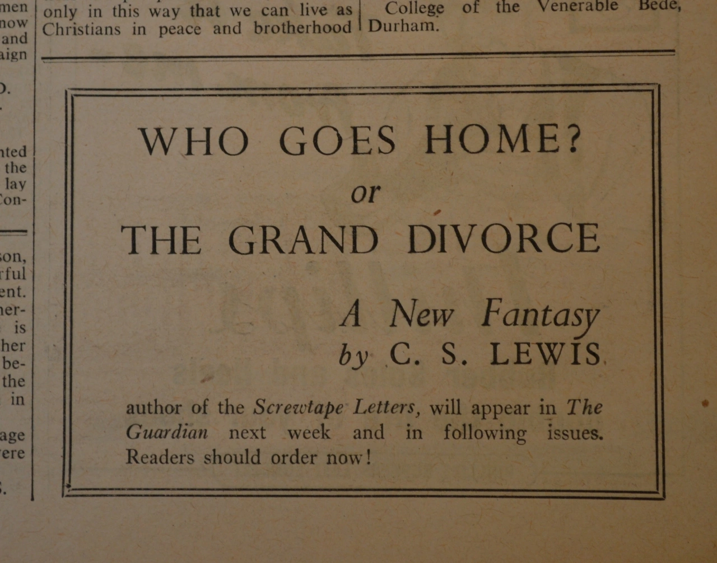
Front matter:
--The title
Originally published as a serial in the Anglican weekly periodical The Guardian, The Great Divorce was originally entitled Who Goes Home? A New Fantasy. The Great Divorce comes from The Marriage of Heaven and Hell by William Blake (1757-1827).
--The frontispiece
The Great Divorce: A Dream
Quotation from George MacDonald
“No, there is no escape. There is no heaven with a little of hell in it - no place to retain this or that of the devil in our hearts or our pockets. Out Satan must go, every hair and feather.”
Influences on Lewis’s writing
During this wartime period, Lewis gives his lectures on Milton and Paradise Lost in Wales, and publishes A Preface to Paradise Lost, in addition to publishing The Screwtape Letters.
Charles Williams, Dorothy Sayers, and Lewis were in frequent dialog and writing about Dante’s The Divine Comedy throughout 1944, with Williams publishing The Figure of Beatrice, Lewis publishing The Great Divorce, and Sayers moving towards translating Dante’s work.

Slide 9
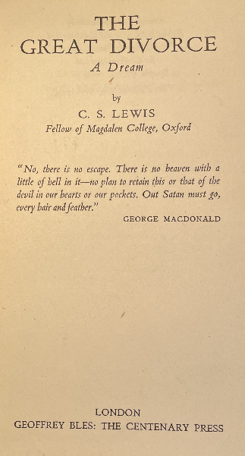
THE PREFACE
“BLAKE WROTE “The Marriage of Heaven and Hell.” If I have written of their Divorce, this is not because I think myself a fit antagonist for so great a genius, nor even because I feel at all sure that I know what he meant. But in some sense or other the attempt to make that marriage is perennial. The attempt is based on the belief that reality never presents us with an absolutely unavoidable "either-or"; that, granted skill and patience and (above all) time enough, some way of embracing both alternatives can always be found; that mere development or adjustment or refinement will somehow turn evil into good without our being called on for a final and total rejection of anything we should like to retain.
“This belief I take to be a disastrous error. You cannot take all luggage with you on all journeys; on one journey even your right hand and your right eye may be among the things you have to leave behind. We are not living in a world where all roads are radii of a circle and where all, if followed long enough, will therefore draw gradually nearer and finally meet at the centre: rather in a world where every road, after a few miles, forks into two, and each of those into two again, and at each fork you must make a decision. Even on the biological level life is not like a pool but like a tree. It does not move towards unity but away from it and the creatures grow further apart as they increase in perfection. Good, as it ripens, becomes continually more different not only from evil but from other good.”
“I do not think that all who choose wrong roads perish; but their rescue consists in being put back on the right road. A wrong sum can be put right: but only by going back till you find the error and working it afresh from that point, never by simply going on. Evil can be undone, but it cannot "develop" into good. Time does not heal it. The spell must be unwound, bit by bit, "with backward

Slide 10
mutters of dissevering power"-or else not. It is still "either-or." If we insist on keeping Hell (or even earth) we shall not see Heaven: if we accept Heaven we shall not be able to retain even the smallest and most intimate souvenirs of Hell. I believe, to be sure, that any man who reaches Heaven will find that what he abandoned (even in plucking out his right eye) was precisely nothing: that the kernel of what he was really seeking even in his most depraved wishes will be there, beyond expectation, waiting for him in "the High Countries." In that sense it will be true for those who have completed the journey (and for no others) to say that good is everything and Heaven everywhere. But we, at this end of the road, must not try to anticipate that retrospective vision. If we do, we are likely to embrace the false and disastrous converse and fancy that everything is good and everywhere is Heaven. But what, you ask, of earth? Earth, I think, will not be found by anyone to be in the end a very distinct place. I think earth, if chosen instead of Heaven, will turn out to have been, all along, only a region in Hell: and earth, if put second to Heaven, to have been from the beginning a part of Heaven itself. There are only two things more to be said about this small book. Firstly, I must acknowledge my debt to a writer whose name I have forgotten and whom I read several years ago in a highly coloured American magazine of what they call " Scientifiction." The unbendable and unbreakable quality of my heavenly matter was suggested to me by him, though he used the fancy for a different and most ingenious purpose. His hero travelled into the past: and there, very properly, found raindrops that would pierce him like bullets and sandwiches that no strength could bite--because, of course, nothing in the past can be altered. I, with less originality but (I hope) equal propriety, have transferred this to the eternal. If the writer of that story ever reads these lines I hope he will accept

Slide 11
my grateful acknowledgment. The second thing is this. I beg readers to remember that this is a fantasy. It has of course-or I intended it to have-a moral. But the transmortal conditions are solely an imaginative supposal: they are not even a guess or a speculation at what may actually await us. The last thing I wish is to arouse factual curiosity about the details of the after-world. C. S. LEWIS April, 1945
MAJOR THEMES IN THE PREFACE
1. You can’t have it all. “The attempt [to marry Heaven and Hell] is based on the belief that reality never presents us with an absolutely unavoidable "either-or"; that, granted skill and patience and (above all) time enough, some way of embracing both alternatives can always be found; that mere development or adjustment or refinement will somehow turn evil into good without our being called on for a final and total rejection of anything we should like to retain. This belief I take to be a disastrous error.”
--Woe unto them that call evil good, and good evil; that put darkness for light, and light for darkness; that put bitter for sweet, and sweet for bitter!—Isaiah 5:20
--They know God’s decree, that those who practice such things deserve to die—yet they not only do them but even applaud others who practice them.—Romans 1:32

Slide 12
MAJOR THEMES IN THE PREFACE
2. Choices matter, and you may be called to renounce things on the journey. “You cannot take all luggage with you on all journeys; on one journey even your right hand and your right eye may be among the things you have to leave behind. We are not living in a world where all roads are radii of a circle and where all, if followed long enough, will therefore draw gradually nearer and finally meet at the centre: rather in a world where every road, after a few miles, forks into two, and each of those into two again, and at each fork you must make a decision. Even on the biological level life is not like a pool but like a tree. It does not move towards unity but away from it and the creatures grow further apart as they increase in perfection. Good, as it ripens, becomes continually more different not only from evil but from other good.”
--Not that I have already obtained this or am already perfect, but I press on to make it my own, because Christ Jesus has made me his own. Brothers, I do not consider that I have made it my own. But one thing I do: forgetting what lies behind and straining forward to what lies ahead, I press on toward the goal for the prize of the upward call of God in Christ Jesus.—Phil. 3:12-14
--If your right eye causes you to sin, tear it out and throw it away. For it is better that you lose one of your members than that your whole body be thrown into hell.—Matt. 5:29
--I count all things to be loss in view of the surpassing value of knowing Christ Jesus my Lord, for whom I have suffered the loss of all things, and count them but rubbish so that I may gain Christ.—Phil. 3:8
--And Jesus summoned the crowd with His disciples, and said to them, “If anyone wishes to come after Me, he must deny himself, and take up his cross and follow Me.—Mk. 8:34

Slide 13
MAJOR THEMES IN THE PREFACE
3. Repentance and a new start are prerequisites for the journey. “I do not think that all who choose wrong roads perish; but their rescue consists in being put back on the right road. A wrong sum can be put right: but only by going back till you find the error and working it afresh from that point, never by simply going on. Evil can be undone, but it cannot "develop" into good. Time does not heal it. The spell must be unwound, bit by bit, "with backward mutters of dissevering power"-or else not. It is still "either-or." If we insist on keeping Hell (or even earth) we shall not see Heaven: if we accept Heaven we shall not be able to retain even the smallest and most intimate souvenirs of Hell.
--Godly sorrow brings repentance that leads to salvation and leaves no regret, but worldly sorrow brings death.– 2 Cor. 7:10
⁻⁻I have been crucified with Christ and I no longer live, but Christ lives in me. The life I now live in the body, I live by faith in the Son of God, who loved me and gave himself for me.—Gal. 2:20
--Christ died for all, that those who live might no longer live for themselves but for him who for their sake died and was raised. From now on, therefore, we regard no one according to the flesh. Even though we once regarded Christ according to the flesh, we regard him thus no longer. Therefore, if anyone is in Christ, he is a new creation. The old has passed away; behold, the new has come. --2 Cor. 5:16-17

Slide 14
MAJOR THEMES IN THE PREFACE
4. Anything we leave behind will pale in the face of what God has in store. “I believe, to be sure, that any man who reaches Heaven will find that what he abandoned (even in plucking out his right eye) was precisely nothing: that the kernel of what he was really seeking even in his most depraved wishes will be there, beyond expectation, waiting for him in "the High Countries.”
--“Eye has not seen, nor ear heard, nor have entered into the heart of man the things which God has prepared for those who love Him.”—I Cor. 2:9
--For I consider that the sufferings of this present time are not worth comparing with the glory that is to be revealed to us. --Romans 8:18
--Rejoice and be exceedingly glad, for your reward is great in heaven, for so they persecuted the prophets who were before you.—Matt. 5:12
5. This story is a fantasy and a supposal, not a factual description of the after-life. I beg readers to remember that this is a fantasy. It has of course -- or I intended it to have- -- a moral. But the transmortal conditions are solely an imaginative supposal: they are not even a guess or a speculation at what may actually await us. The last thing I wish is to arouse factual curiosity about the details of the after-world.
--Dear friends, now we are children of God, and what we will be has not yet been made known. But we know that when Christ appears, we shall be like him, for we shall see him as he is.—I Jn 3:2
--For this light momentary affliction is preparing for us an eternal weight of glory beyond all comparison, ¹⁸ as we look not to the things that are seen but to the things that are unseen. For the things that are seen are transient, but the things that are unseen are eternal.—2 Cor. 4:17

Slide 15
WALK ON—U2
From ”All That You Can’t Leave Behind”
And love is not the easy thing, the only baggage that you can bring Is all that you can't leave behind
You're packing a suitcase for a place none of us has been A place that has to be believed to be seen
Walk on, walk on--what you've got they can't deny it Can't sell it, or buy it Walk on, walk on--stay safe tonight
And I know it aches and your heart it breaks And you can only take so much: Walk on
Home, hard to know what it is if you've never had one Home, I can't say where it is but I know I'm going home Leave it behind--you've got to leave it all behind
All that you fashion, all that you make All that you build, all that you break All that you measure, all that you steal All this you feel, all that you reason All that you sense, all that you speak All you dress up and all that you scheme All you create and all that you wreck All that you hate.

Slide 16
“I believe, to be sure, that any man who reaches Heaven will find that what he abandoned (even in plucking out his right eye) has not been lost: that the kernel of what he was really seeking even in his most depraved wishes will be there, beyond expectation, waiting for him in 'the High Countries'.” ― C.S. Lewis, The Great Divorce

