Slide 1
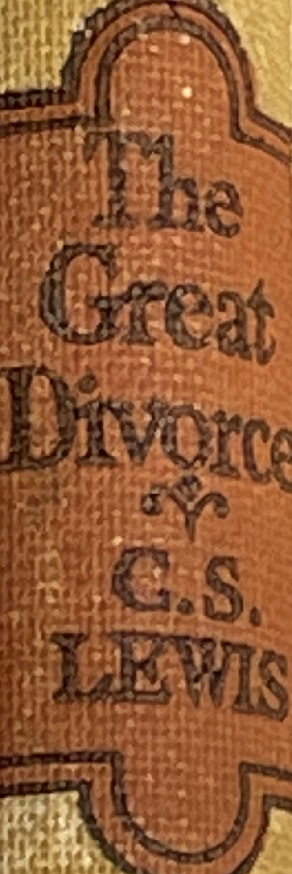
October 26, 2022 St. Philip’s Church The Rev’d Brian K. McGreevy, J.D., Facilitator
The Great Divorce:
C.S. Lewis on God’s Truth
or Your Truth

Slide 2
In the presence of God and of Christ Jesus, who will judge the living and the dead, and in view of his appearing and his kingdom, I give you this charge: Preach the word; be prepared in season and out of season; correct, rebuke and encourage—with great patience and careful instruction.
For the time will come when people will not put up with sound doctrine. Instead, to suit their own desires, they will gather around them a great number of teachers to say what their itching ears want to hear. They will turn their ears away from the truth and turn aside to myths. But you, keep your head in all situations, endure hardship, do the work of an evangelist, discharge all the duties of your ministry. (2 Timothy 4:1-4)

Slide 3
How to approach this class: --On the beach --Snorkeling --Scuba diving --Email list How to read this book: --Try reading aloud --One chapter at a time
AN ANNOUNCEMENT!

Slide 4
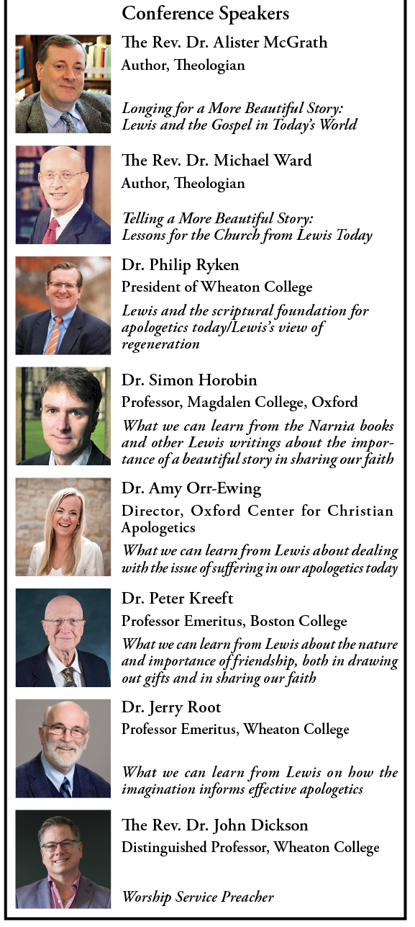
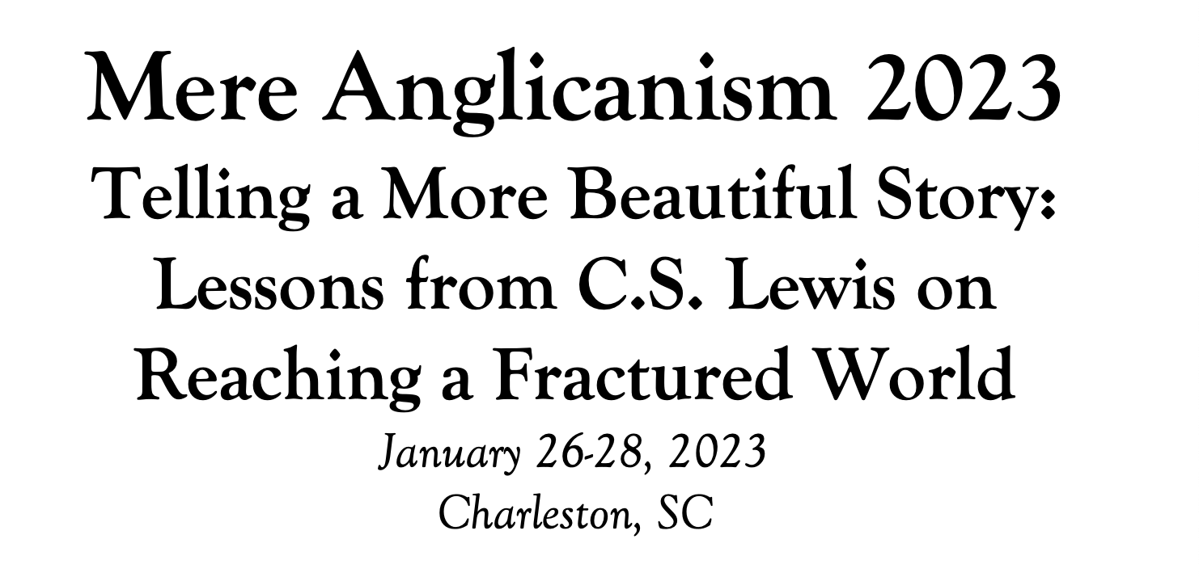

Slide 5
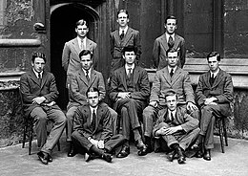
Tonight’s Music!
REVIEW
Why does The Great Divorce merit study today?
--Emphasis on eternal life with a vivid description of the awfulness of Hell and the glorious beauty of Heaven that will fire your heart with longing
--Narcissism and pride are rife in our culture today, and Lewis shows the consequences of both.
--Truth as an absolute is under cultural attack as never before, with the idea of speaking your own truth held up as the highest good. Lewis shows decisively in this story what happens when you hold onto your own ”truth” and refuse to acknowledge God’s Truth.
--Obsession in our culture about our Rights and what we are owed, rather than focusing on servanthood and self-sacrifice
--Clarity about either/or rather than gray view of choices
--A brilliant rebuttal of works righteousness in favor of the centrality of the Cross

Slide 6
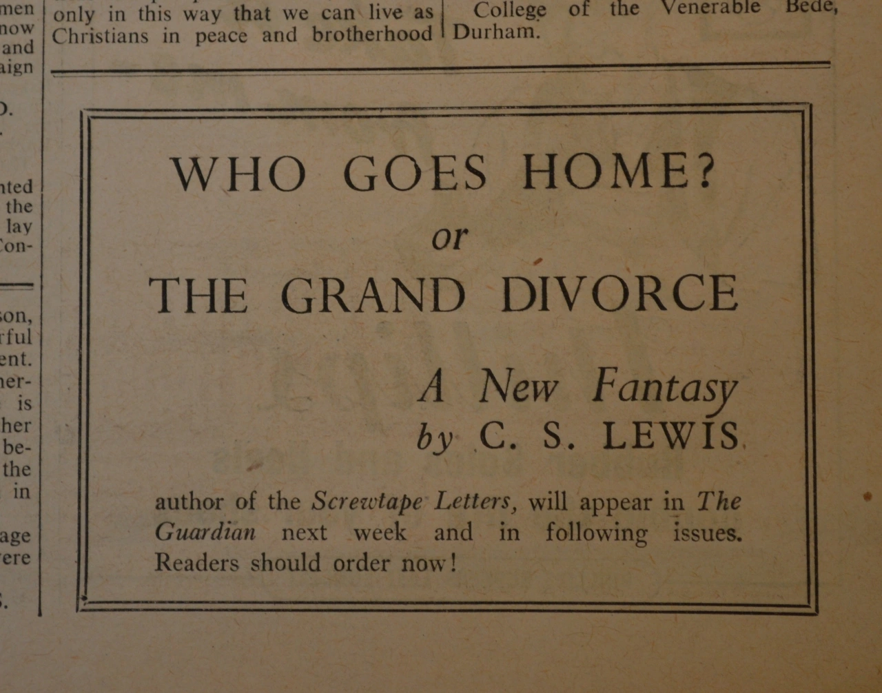
Front matter:
--The title
Originally published as a serial in the Anglican weekly periodical The Guardian, The Great Divorce was originally entitled Who Goes Home? A New Fantasy. The Great Divorce comes from The Marriage of Heaven and Hell by William Blake (1757-1827).
--The frontispiece
The Great Divorce: A Dream
Quotation from George MacDonald
“No, there is no escape. There is no heaven with a little of hell in it - no place to retain this or that of the devil in our hearts or our pockets. Out Satan must go, every hair and feather.”
Influences on Lewis’s writing
During this wartime period, Lewis gives his lectures on Milton and Paradise Lost in Wales, and publishes A Preface to Paradise Lost, in addition to publishing The Screwtape Letters.
Charles Williams, Dorothy Sayers, and Lewis were in frequent dialog and writing about Dante’s The Divine Comedy throughout 1944, with Williams publishing The Figure of Beatrice, Lewis publishing The Great Divorce, and Sayers moving towards translating Dante’s work.

Slide 7
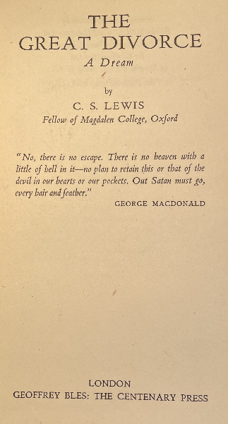
MAJOR THEMES IN THE PREFACE
1. You can’t have it all. “The attempt [to marry Heaven and Hell] is based on the belief that reality never presents us with an absolutely unavoidable "either-or"; that, granted skill and patience and (above all) time enough, some way of embracing both alternatives can always be found; that mere development or adjustment or refinement will somehow turn evil into good without our being called on for a final and total rejection of anything we should like to retain. This belief I take to be a disastrous error.”
2. Choices matter, and you may be called to renounce things on the journey. “You cannot take all luggage with you on all journeys; on one journey even your right hand and your right eye may be among the things you have to leave behind. We are not living in a world where all roads are radii of a circle and where all, if followed long enough, will therefore draw gradually nearer and finally meet at the centre.”
3. Repentance and a new start are prerequisites for the journey. “I do not think that all who choose wrong roads perish; but their rescue consists in being put back on the right road. A wrong sum can be put right: but only by going back till you find the error and working it afresh from that point, never by simply going on. Evil can be undone, but it cannot "develop" into good.”
4. Anything we leave behind will pale in the face of what God has in store. “I believe, to be sure, that any man who reaches Heaven will find that what he abandoned (even in plucking out his right eye) was precisely nothing: that the kernel of what he was really seeking even in his most depraved wishes will be there, beyond expectation, waiting for him in "the High Countries.”
5. This story is a fantasy and a supposal, not a factual description of the after-life. I beg readers to remember that this is a fantasy. It has of course -- or I intended it to have- -- a moral. But the transmortal conditions are solely an imaginative supposal: they are not even a guess or a speculation at what may actually await us. The last thing I wish is to arouse factual curiosity about the details of the after-world.

Slide 8
Chapter 1
“I SEEMED to be standing in a bus queue by the side of a long, mean street. Evening was just closing in and it was raining. I had been wandering for hours in similar mean streets, always in the rain and always in evening twilight. Time seemed to have paused on that dismal moment when only a few shops have lit up and it is not yet dark enough for their windows to look cheering. And just as the evening never advanced to night, so my walking had never brought me to the better parts of the town. However far I went I found only dingy lodging houses, small tobacconists, hoardings from which posters hung in rags, windowless warehouses, goods stations without trains, and bookshops of the sort that sell The Works of Aristotle. I never met anyone. But for the little crowd at the bus stop, the whole town seemed to be empty. I think that was why I attached myself to the queue.
“I had a stroke of luck right away, for just as I took my stand a little waspish woman who would have been ahead of me snapped out at a man who seemed to be with her, "Very well, then. I won't go at all. So there," and left the queue. "Pray don't imagine," said the man, in a very dignified voice, "that I care about going in the least. I have only been trying to please you, for peace sake. My own feelings are of course a matter of no importance. I quite understand that"-and suiting the action to the word he also walked away. "Come," thought I, "that's two places gained." I was now next to a very short man with a scowl who glanced at me with an expression of extreme disfavour and observed, rather unnecessarily loudly, to the man beyond him, "This sort of thing really makes one think twice about going at all." "What sort of thing?" growled the other, a big beefy person. "Well," said the Short Man, "this is hardly the sort of society I'm used to as a matter of fact." "Huh!" said the Big Man: and then added with a glance at me, "Don't you stand any sauce from him, Mister. You're not afraid of him, are you?" Then, seeing I made no move, he rounded suddenly on the Short Man and said, "Not good enough for you, aren't we? Like your lip." Next moment he had fetched the Short Man one on the side of the face that sent him sprawling into the gutter. "Let him lay, let him lay," said the Big Man to

Slide 9
no one in particular. "I'm a plain man that's what I am and I got to have my rights same as anyone else, see?" As the Short Man showed no disposition to rejoin the queue and soon began limping away, I closed up, rather cautiously, behind the Big Man and congratulated myself on having gained yet another step. A moment later two young people in front of him also left us arm in arm. They were both so trousered, slender, giggly and falsetto that I could be sure of the sex of neither, but it was clear that each for the moment preferred the other to the chance of a place in the bus. "We shall never all get in," said a female voice with a whine in it from some four places ahead of me. "Change places with you for five bob, lady," said someone else. I heard the clink of money and then a scream in the female voice, mixed with roars of laughter from the rest of the crowd. The cheated woman leaped out of her place to fly at the man who had bilked her, but the others immediately closed up and flung her out. ...
“So what with one thing and another the queue had reduced itself to manageable proportions long before the bus appeared. It was a wonderful vehicle, blazing with golden light, heraldically coloured. The Driver himself seemed full of light and he used only one hand to drive with. The other he waved before his face as if to fan away the greasy steam of the rain. A growl went up from the queue as he came in sight. "Looks as if he had a good time of it, eh? ... Bloody pleased with himself, I bet. ... My dear, why can't he behave naturally? Thinks himself too good to look at us. ... Who does he imagine he is? ... All that gilding and purple, I call it a wicked waste. Why don't they spend some of the money on their house property down here? God! I'd like to give him one in the ear-'ole." I could see nothing in the countenance of the Driver to justify all this, unless it were that he had a look of authority and seemed intent on carrying out his job.
“My fellow passengers fought like hens to get on board the bus though there was plenty of room for us all. I was the last to get in. The bus was only half full and I selected a seat at the back, well away from the others but a tousle-headed youth at once came and sat down beside me. As he did so we moved off.

Slide 10
"I thought you wouldn't mind my tacking on to you," he said, "for I've noticed that you feel just as I do about the present company. Why on earth they insist on coming I can't imagine. They won't like it at all when we get there, and they'd really be much more comfortable at home. It's different for you and me." "Do they like this place?" I asked. "As much as they'd like anything," he answered. "They've got cinemas and fish and chip shops and advertisements and all the sorts of things they want. The appalling lack of any intellectual life doesn't worry them. I realised as soon as I got here that there'd been some mistake. I ought to have taken the first bus but I've fooled about trying to wake people up here. I found a few fellows I'd known before and tried to form a little circle, but they all seem to have sunk to the level of their surroundings. Even before we came here I'd had some doubts about a man like Cyril Blellow. I always thought he was working in a false idiom. But he was at least intelligent: one could get some criticism worth hearing from him, even if he was a failure on the creative side. But now he seems to have nothing left but his self-conceit. The last time I tried to read him some of my own stuff . . . but wait a minute, I'd just like you to look at it.”
“Realising with a shudder that what he was producing from his pocket was a thick wad of typewritten paper, I muttered something about not having my spectacles and exclaimed, "Hullo! We've left the ground." It was true. Several hundred feet below us, already half hidden in the rain and mist, the wet roofs of the town appeared, spreading without a break as far as the eye could see.”

Slide 11
OBSERVATIONS FROM CHAPTER 1
Description of the place where the narrator is
--Raining, dreary, endless, mean, dismal, dingy, empty
Description of the people he encounters at the bus stop
--mix of social classes, waspish, scowling, loud, complaining, disfavouring, argumentative, violent, whining, cheating, bullying, excluding, fighting: some scholars posit a link with the seven deadly sins (Envy, Gluttony, Greed, Lust, Pride, Sloth, Wrath)
Description of the bus and driver
--wonderful, blazing, full of light, colorful, plenty of room, authoritative, responsible, focused—and the bus can fly!
Description of people are leaving the queue
--the arguing husband and wife, the short man who was punched, the trousered self-absorbed couple, the cheated woman
The tousle-headed youth and what we learn from him
--assumes instant intimacy with narrator based on looks, shares information
--he has been there a while, he believes he is in the wrong place, there has been more than one bus, the people are comfortable where they are and like it as much as they are capable of liking anything, he feels there is no intellectual life, he has been unsuccessful in trying to wake his peers or form a circle of them, he is a writer of some sort

Slide 12
Some of Lewis’s likely inspirations seen in Chapter One
The Refrigerium
“Did ye never hear of the Refrigerium? A man with your advantages might have read of it in Prudentius, not to mention Jeremy Taylor.” George MacDonald in Ch. 9 of The Great Divorce
Prudentius: an early Roman Christian poet, author of hymns like “Of the Father’s Love Begotten” and “Earth Has Many a Noble City”—Lewis knew his work well.
Jeremy Taylor: a 17th century Anglican divine whose 1650 sermon “Christ’s Advent to Judgment”talks about the Catholic idea of the Refrigerium mentioned in Prudentius– the idea that the damned are given occasional repose from the torments of Hell by being granted “days off” in other places.
“The Celestial Omnibus”—short story by E.M. Forster (1911)
Forster was a well-known and popular British author some twenty years older than Lewis
This short story focuses on a boy with a strong sense of wonder who sees a sign at a bus stop saying “To Heaven.” His pseudo-intellectual parents and their friends mock him. The boy actually finds the bus and travels to Heaven and is overcome with wonder at its beauty. One of his parents’ snobbish friends goes with the boy the next time but finds a different bus, where Dante is the guide and where there is a quotation from the Inferno slightly altered to say “Abandon self-importance” rather than “Abandon hope.”

Slide 13
MAJOR THEMES IN CHAPTER ONE
1. Bad choices can have lasting consequences. “I ought to have taken the first bus but I've fooled about trying to wake people up here. I found a few fellows I'd known before and tried to form a little circle, but they all seem to have sunk to the level of their surroundings.” “But each person is tempted when he is lured and enticed by his own desire. Then desire when it has conceived gives birth to sin, and sin when it is fully grown brings forth death.” (James 1:14-15) Now the works of the flesh are evident: sexual immorality, impurity, sensuality, idolatry, sorcery, enmity, strife, jealousy, fits of anger, rivalries, dissensions, divisions, envy, drunkenness, orgies, and things like these. I warn you, as I warned you before, that those who do such things will not inherit the kingdom of God. But the fruit of the Spirit is love, joy, peace, patience, kindness, goodness, faithfulness, gentleness, self-control; against such things there is no law. (Galatians 5:19-23)
2. The children of darkness disdain the children of light. “A growl went up from the queue as he came in sight. "Looks as if he had a good time of it, eh? ... Bloody pleased with himself, I bet. ... My dear, why can't he behave naturally? Thinks himself too good to look at us. ... Who does he imagine he is? ... All that gilding and purple, I call it a wicked waste. Why don't they spend some of the money on their house property down here? God! I'd like to give him one in the ear-’ole.” Don’t link up with unbelievers and try to work with them. What common interest can there be between goodness and evil? How can light and darkness share life together? How can there be harmony between Christ and the devil? What business can a believer have with an unbeliever? What common ground can idols hold with the temple of God? For we, remember, are ourselves living temples of the living God, as God has said: ‘I will dwell in them and walk among them. I will be their God, and they shall be my people’. (2 Cor. 6:14 JBP) And this is the judgment: the light has come into the world, and people loved the darkness rather than the light because their works were evil. For everyone who does wicked things hates the light and does not come to the light, lest his works should be exposed. But whoever does what is true comes to the light, so that it may be clearly seen that his works have been carried out in God. (Jn. 3:19-21)

Slide 14
“I believe, to be sure, that any man who reaches Heaven will find that what he abandoned (even in plucking out his right eye) has not been lost: that the kernel of what he was really seeking even in his most depraved wishes will be there, beyond expectation, waiting for him in 'the High Countries'.” ― C.S. Lewis, The Great Divorce

